Slide 1
Reputation Management
Melodie Carli

Slide 2
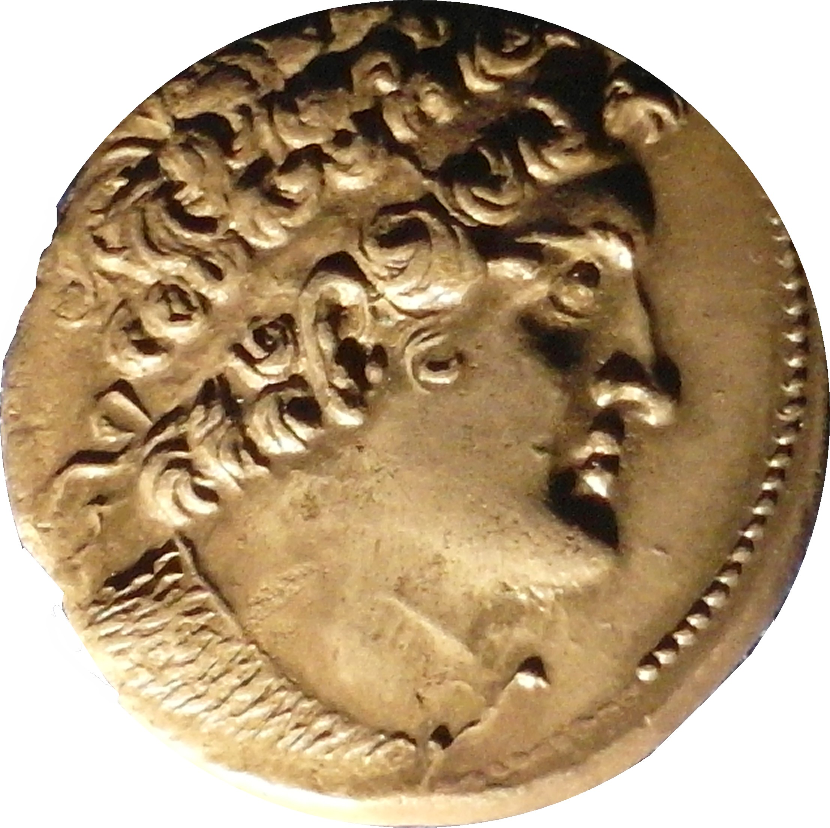
Ptolemy VIII
Ptolemy VIII Euergetes II (c.182 BC – June 26 116 BC), nicknamed Physcon, was a king of the Ptolemaic dynasty in Egypt
Ptolemy VIII's complicated political career started in 170 BC. This is when Antiochus IV Epiphanes of the Seleucid Empire invaded and captured King Ptolemy VI Philometor and all of Egypt, with the exception of the city of Alexandria.
Antiochus allowed Ptolemy VI to continue as a puppet monarch. Meanwhile, the people of Alexandria chose Ptolemy Euergetes, his younger brother, as king. Euergetes was popularly known as Physcon, meaning sausage, due to his obesity. Instead of taking up arms against one another, the brothers decided to co-rule Egypt.

Slide 3
Cultural Disasters under Ptolemy VIII
For all its great reputation as the intellectual capital of the Hellenistic world, Alexandria did not maintain that position for ever.
An enormous blow to its reputation came in 145 BCE: when Ptolemy VIII expelled nearly all the leading intellectual lights of his capital city in a fit of unexplained pique.
He removed Aristarchus of Samothrace, a man of world-wide scholarly reputation, as the head of the famous Library, replacing him with a low-level military officer, so as to deepen the insult.
The Museum and its scholars suffered similarly. As a consequence, even when the city was to regain some of its intellectual prestige in later years, it never quite recovered from this needless blow.
During the Mitradaic war, many writers, artists, and thinkers from all over the region fled to Alexandria to avoid this clash between Rome and the Pontic kingdom. Rome, now an intellectual center in its own right, also benefited from this flight.

Slide 4
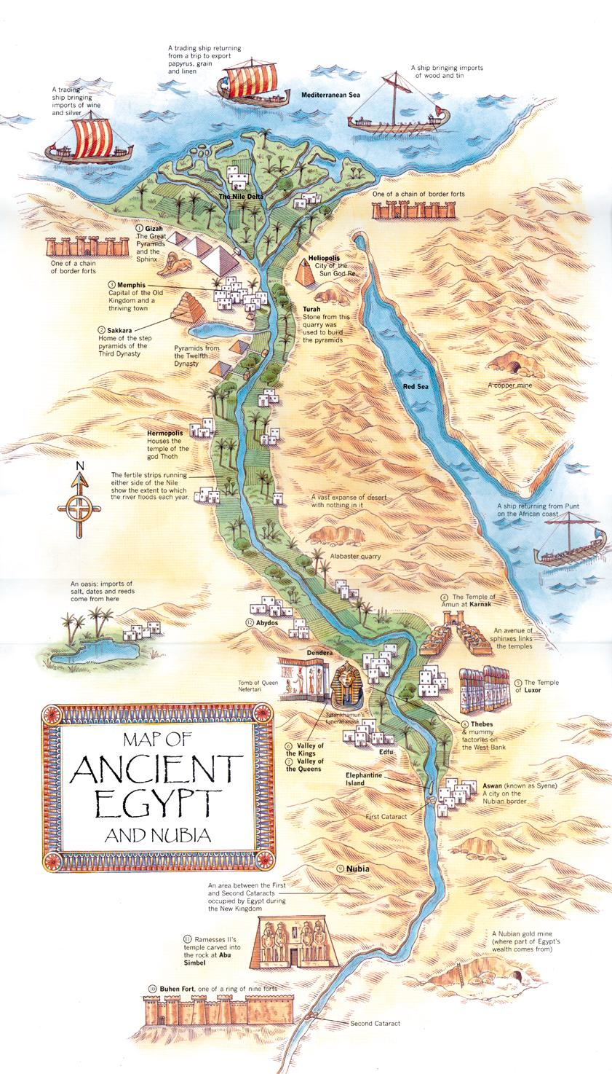
Situation analysis
As Ptolemy VIII is facing a difficult situation and is no longer respected by his people we need to reestablish confidence, trust and loyatly to their king.
Need to bring back the intellectuals

Slide 5
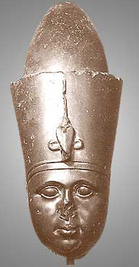
Objectives
Promoting the dynasties of Ptolemy VIII by strengthening ties between Romans & Egyptians.
To improve relationships between Egyptians & Romans by allowing the intellectual to come back
Build trust, a strong and better reputation
Have a better influence
Build a better image
Bring awareness

Slide 6
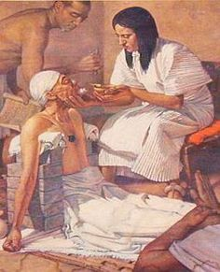
Keys to a good reputation
Do what you say you will do.
Go out of your way to help others reach their goals.
Make other people look good
Go a step beyond what is expected.
Be consistent
Act with integrity.
Get engaged with your community.
Be likable

Slide 7
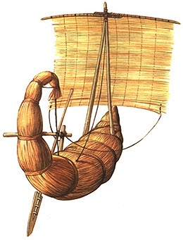
Strategy
Organize monthly meetings with respective classes
Listen to the need of each classes
Answer those needs
Delegate the work and trust surroundings
Make meaningful offers to population
Organize praying sessions to the Gods

Slide 8
Audiences

Slide 9
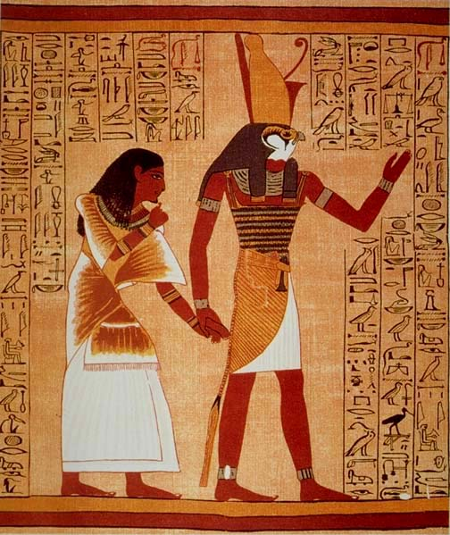
Messages
Democracy
Equality
Worship animals and Gods
Good to the people
Peace and some type of equality

Slide 10
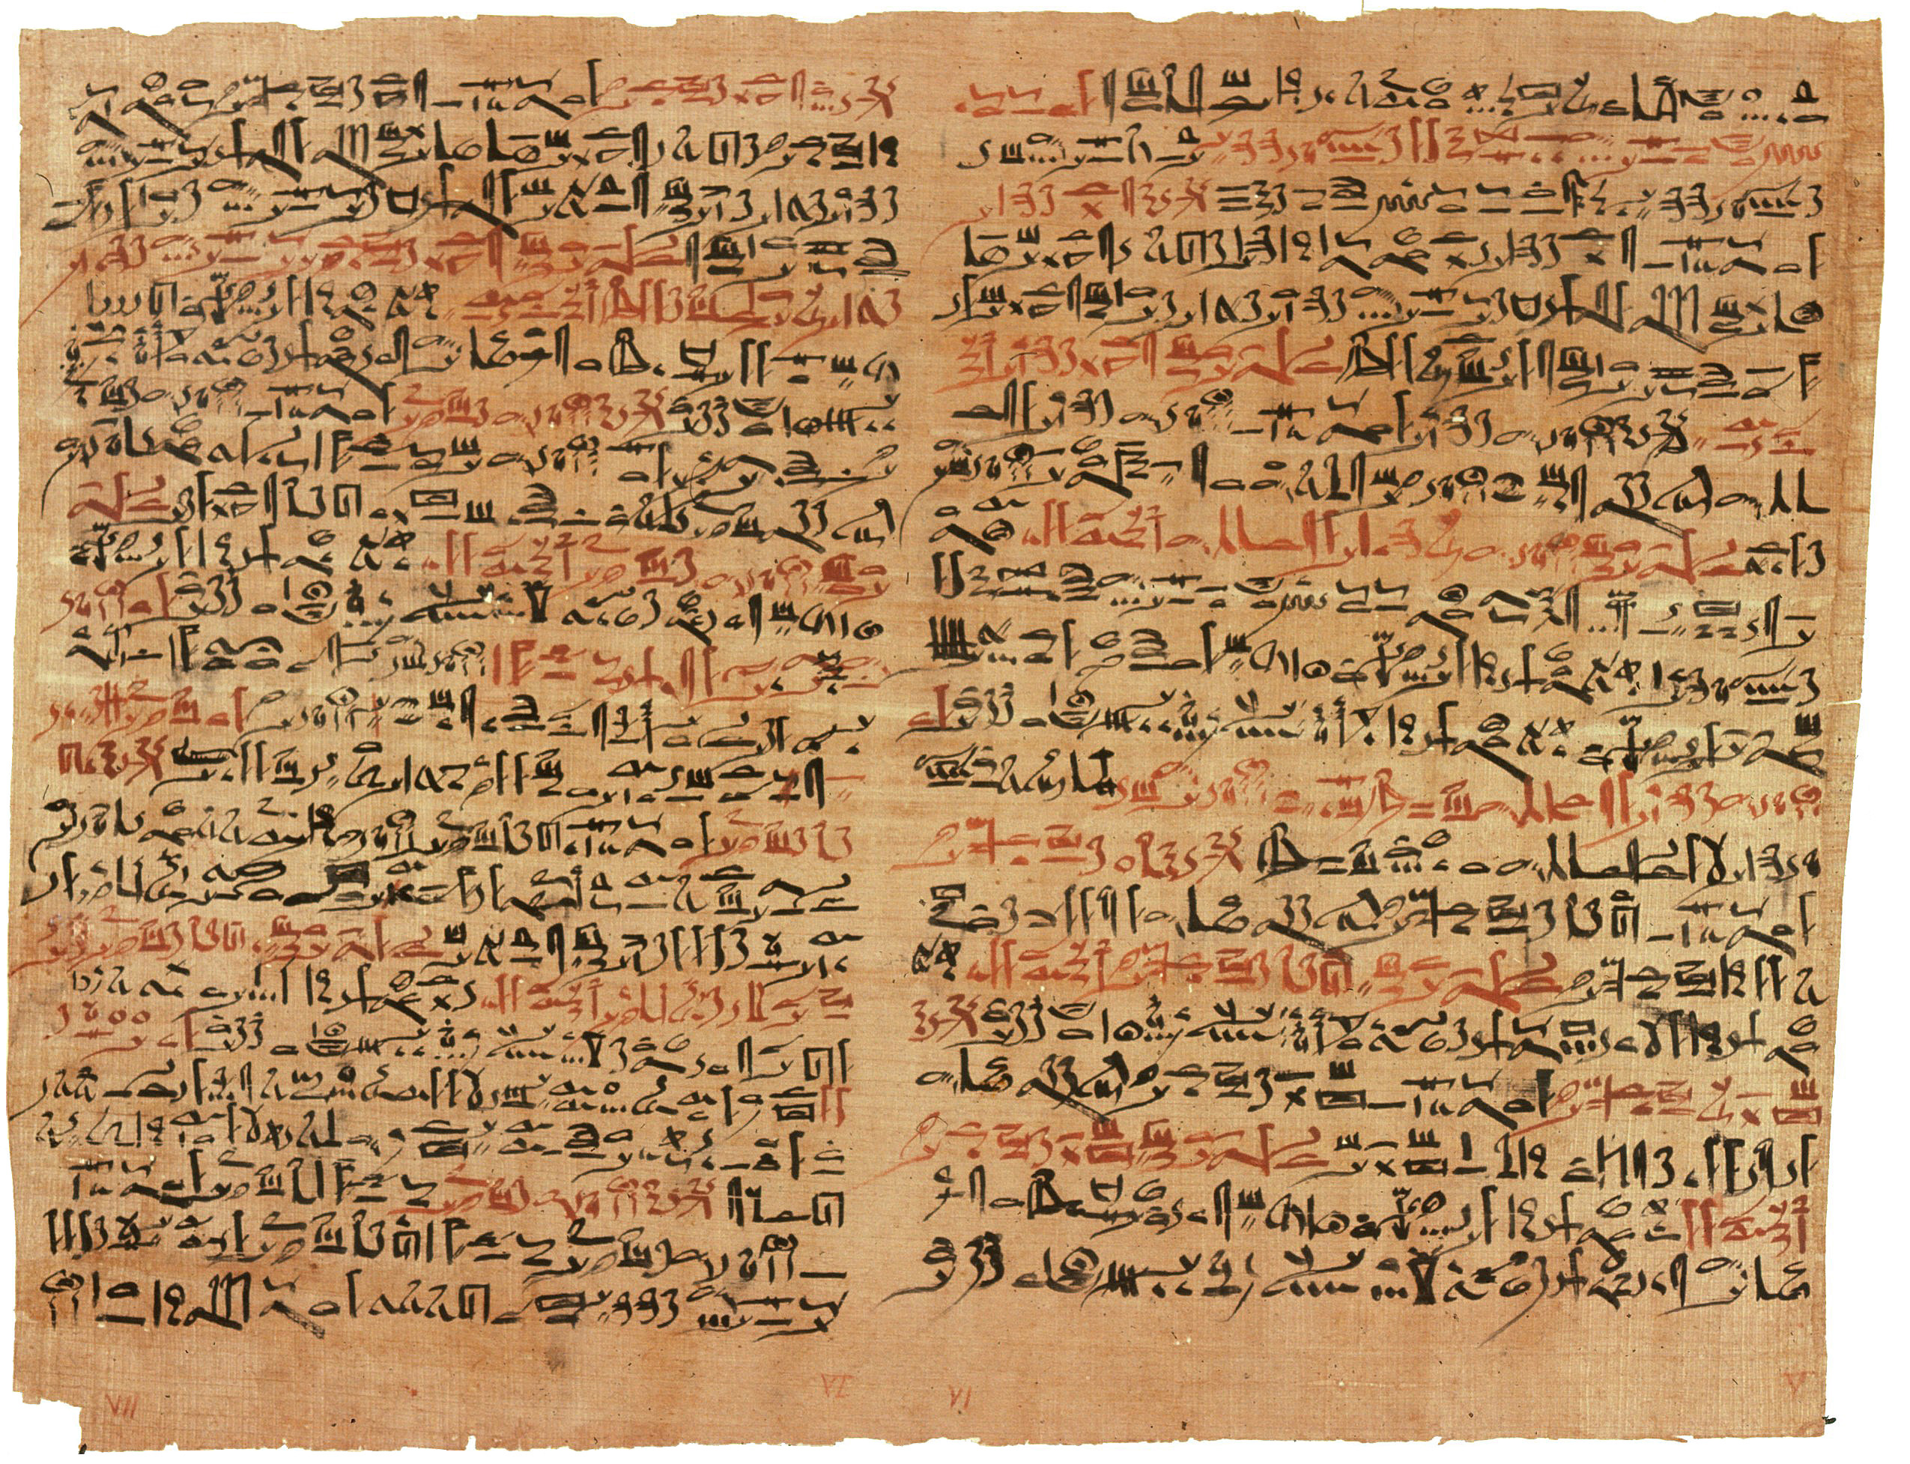
Tactics
Papyrus
Art
Monuments
Donations

Slide 11
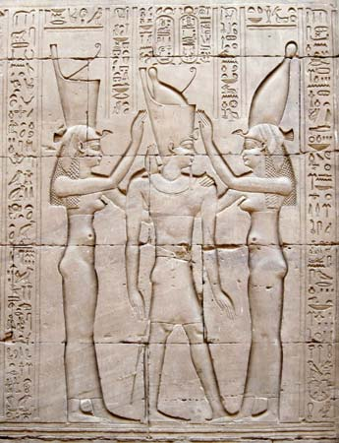
Results
Give credibility to Ptolemy VIII as a ruler
Allows him to restore Ancient Egypt and not fall to Roman Empire
Ptolemy VIII has a new image
He becomes symbol for equality, generosity and a true leader & ruler.

