Slide 1
PUBLIC RELATIONS
Art and Culture through PR eyes.

Slide 2
Art and culture through PR eyes.
Fact - The use of art has always been foundational in building civilizations and establishing culture.
But this is Sociological topic, is it not?
Yes-
“Establishing norms and social facts is essential for the existence of any community.”-1 (Durkheim)
But also, maybe not –

Slide 3
Art and culture through PR eyes.
How would this work?-
“The conscious and intelligent manipulation of the organized habits and opinions of the masses is an important element in democratic societies. Those who manipulate this unseen mechanism of society constitute an invisible government which is the true ruling power of our country.” -2 (Bernays)
“democratic societies” = maybe all societies.

Slide 4
Cultural examples through history.
Egyptian
Hellenic
Chinese
Mayan
A lot of what we know about these cultures is made possible by Art.
Art is a Propaganda in disguise.
Representation makes these cultures possible.

Slide 5
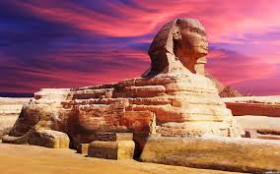
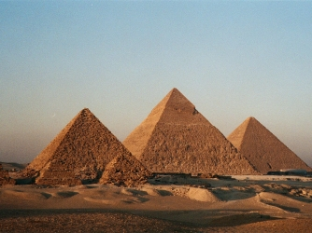
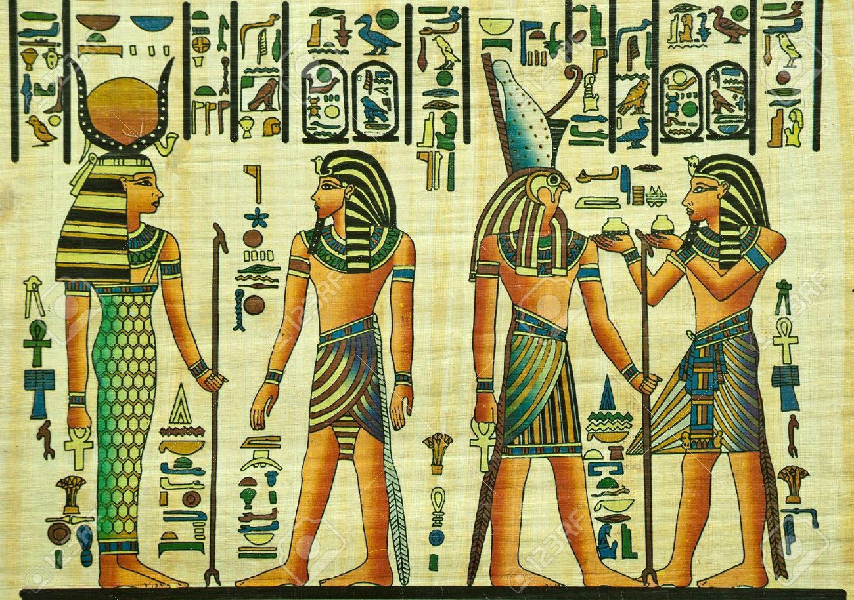
Egyptian
Culture of:
Authority
Divinity
Kingdom
Mass following
Military power

Slide 6
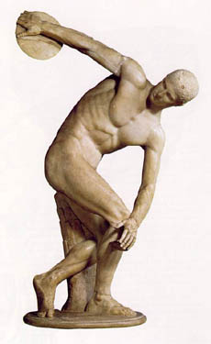
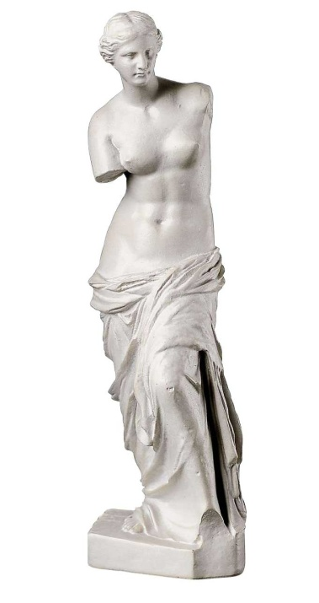
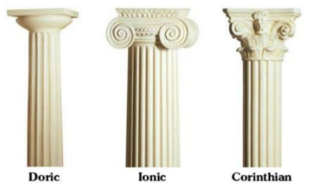
Hellenic
Culture of:
Democracy
Individualism
Philosophy
Athleticism
3- Pleasure in the job puts perfection in the work.

Slide 7
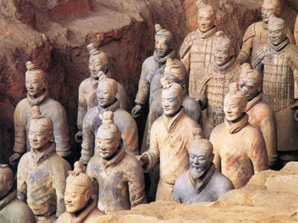
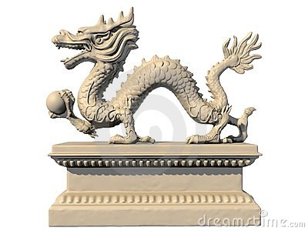
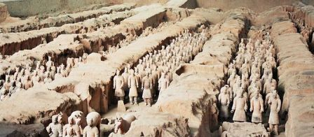
Chinese
4-“Supreme excellence consists of breaking the enemy’s resistance without fighting.”
Culture of:
Discipline
Collectivism
Authority

Slide 8
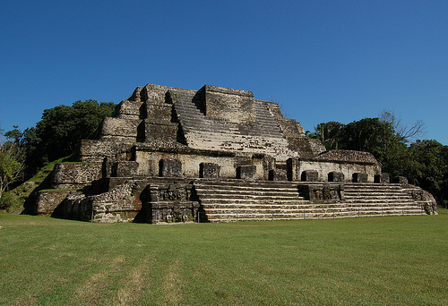
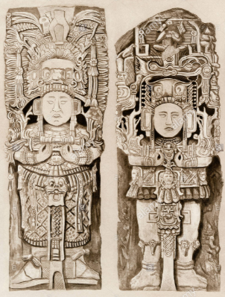
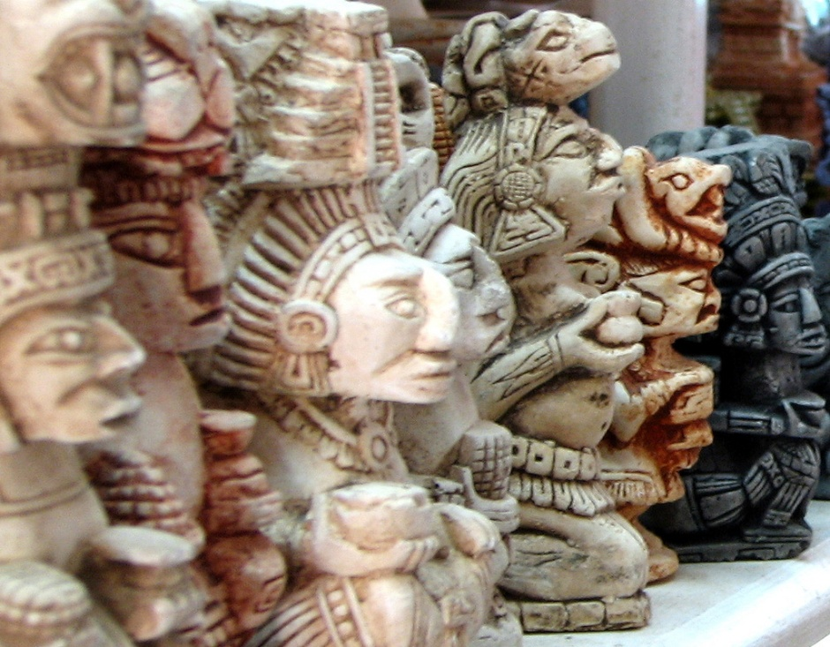
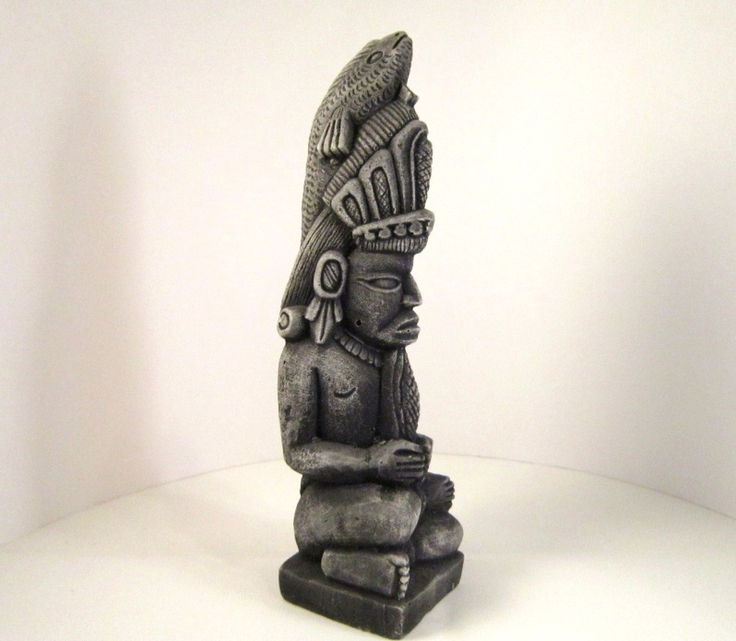
Mayan
It is not good to look at the clouds or your work will not progress (proverb)
Culture of:
Spirituality
Naturalism
Virtue of natural labor

Slide 9
SOURCES
The museum of Louvre
The British Museum
1- Durkheim, Émile, and Anthony Giddens. Selected Writings. Cambridge: U, 1972. Print.
2- Bernays, Edward L., and Mark Crispin. Miller. Propaganda. Brooklyn, NY: Ig Pub., 2005. Print.
3-Aristoteles, and Robert C. Bartlett. Nicomachean Ethics. Chicago: U of Chicago, 2012. Print.
4- Sun, TZU, and S. B. Griffiths. The Art of War. Place of Publication Not Identified: Oxford U, 1971. Print.

